Slide 1
Library Management System (LMS) - Capstone Project Full Stack Web Development Project
Ma Letian Apr 1 2025
Notes:
Good evening everyone. My name is Letian, and I’m excited to present my Capstone Project: Which is a Library Management System.

Slide 2
Project Overview
Web Application for Library Management
A Library Management System (LMS) designed to streamline library operations
Supports two main user roles:
Librarian (Admin): Manages books and users
Member: Searches for books, borrows, returns, and tracks due dates
Built using:
Spring Boot (Backend)
React (Frontend)
MySQL (Database)
Notes:
This project is a web application designed to streamline library operations.
🔹 Two main user roles:
Librarian (Admin) – Manages books and users.
Member – Searches for books, borrows, returns, and tracks due dates.
🔹 Tech Stack:
Backend: Spring Boot
Frontend: React.js
Database: MySQL
This system ensures efficient management of books, members, and borrowing processes.

Slide 3
Project Goals
Develop a fully functional web application for managing library operations
Empower librarians with an efficient way to manage books and members
Enhance user experience by providing a seamless interface for members
Ensure scalability and performance for future expansion
Notes:
The main objectives of this project are:
✅ Develop a fully functional web application for managing library operations.
✅ Enable librarians to efficiently manage books and members.
✅ Enhance user experience with a user-friendly interface.
✅ Ensure scalability to accommodate future expansions.

Slide 4
Key Features
User Management:
Registration, login, profile updates, and password reset
Member Management:
Librarians can register, edit, delete, and search for members
Book Management:
Add, update, delete, and search for books
Notes:
The Library Management System includes:
Registration and Login 📌 User Management – Admin can Register, update users, delete users and reset password. 📌 Book Management – Add, update, delete, and search for books. 📌 Member Management – Users can search, borrow, and return books

Slide 5
Business Rules
Role-Based Access Control (RBAC)
Admin can manage books and users
Members can search, borrow and return books
Secure Authentication & Authorization
Users must log in to access their respective portals
JWT-based authentication for secure session handling
User Registration & Validation Rules
Password must be at least 6 characters long.
Unique email and username required during registration.
Structured API Endpoints for Efficiency
CRUD operations for books & users implemented with RESTful APIs.
Endpoints structured for scalability and maintainability.
Notes:
I implemented several key rules to ensure smooth operation:
🔹 Role-Based Access Control (RBAC) – Librarians manage books and users, while members can only search and borrow books. 🔹 Secure Authentication – JWT-based authentication ensures only authorized users can access the system. 🔹 User Registration Rules – Strong password validation and unique credentials are enforced. 🔹 Book Borrowing & Returning Rules – Members can borrow only a limited number of books and must return them before due dates. 🔹 Structured API Endpoints – RESTful APIs ensure efficiency and scalability.
These rules ensure data security, integrity, and efficient library operations.

Slide 6
Technical Requirements
Backend | Frontend | Database | Security & Performance
Spring Boot (RESTful API) | React.js (User Interface) | MySQL (Database) | JWT Authentication (Secure logins)
Spring Security (JWT Authentication) | React Router (Navigation) | Relationship mapping (Books ↔ Users) | Role-Based Access Control (Admin vs. Member)
 | Axios (API Calls) | Data validation & integrity | Optimized queries (Faster response times)
Notes:
Slide 6: Technical Requirements
To build the system, I used: 🛠 Backend: Spring Boot (REST API, Spring Security, JPA/Hibernate). 🛠 Frontend: React.js to build the user interface (React Router, Hooks, Axios). 🛠 Database: MySQL with proper relationship mapping and validation.
This ensures a robust, secure, and scalable system.

Slide 7
System Architecture
Architecture Type: MVC (Model-View-Controller)
Model (Spring Boot, MySQL) → Handles data & logic
View (React.js, Bootstrap/Material-UI) → User Interface
Controller (Spring Boot, REST API) → Manages API requests
Notes:
The system follows the MVC (Model-View-Controller) architecture: 📌 Model: Handles data and business logic (Spring Boot, MySQL). 📌 View: User interface built with React.js and Material-UI. 📌 Controller: Manages API requests and processes data.
MVC provides a clear separation of concerns, making the system scalable and maintainable.
Why MVC? ✔ Modular Development – Easier debugging & updates ✔ Separation of Logic & UI – Frontend & backend work independently ✔ Reusability – Logic can be reused for future enhancements

Slide 8
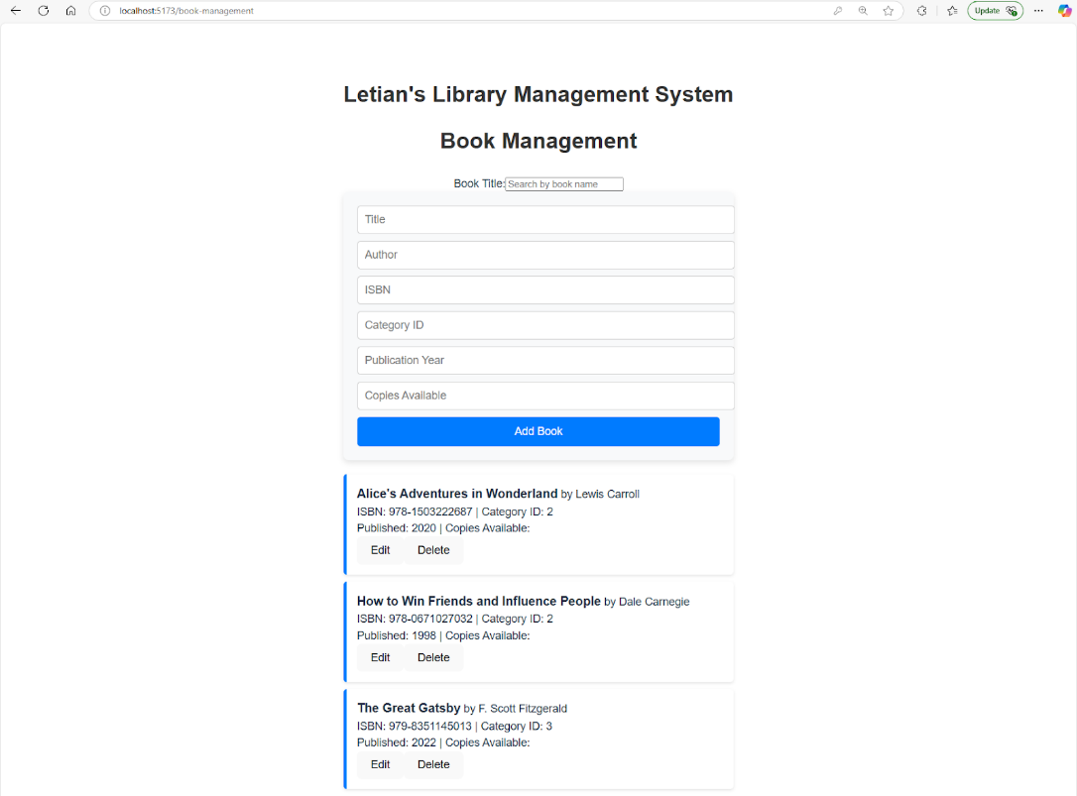
Screenshots of Key Features: Book Management
Notes:
Here are some screenshots demonstrating some key features: 📌 Book Management – search, Adding, updating, and deleting books.

Slide 9
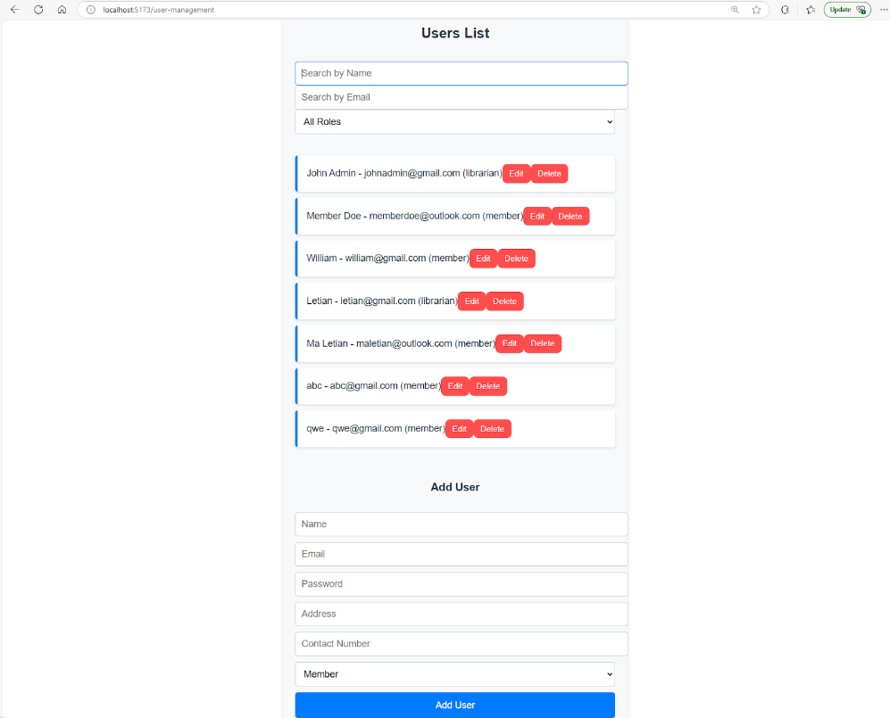
Screenshots of Key Features: User Management
Notes:
📌 User Management – Registering, searching, and editing members.

Slide 10
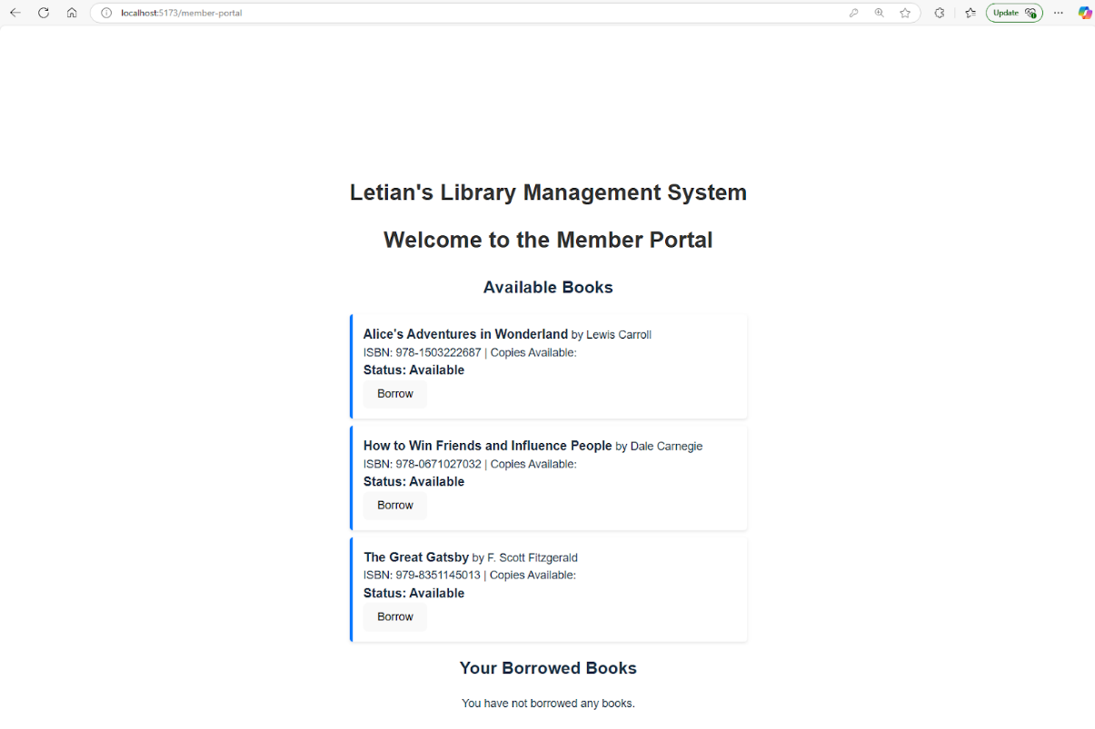
Screenshots of Key Features: Member Management
Notes:
📌 Member Management – Borrowing, returning, and reserving books.
These showcase the functionality and user experience of the system.

Slide 11
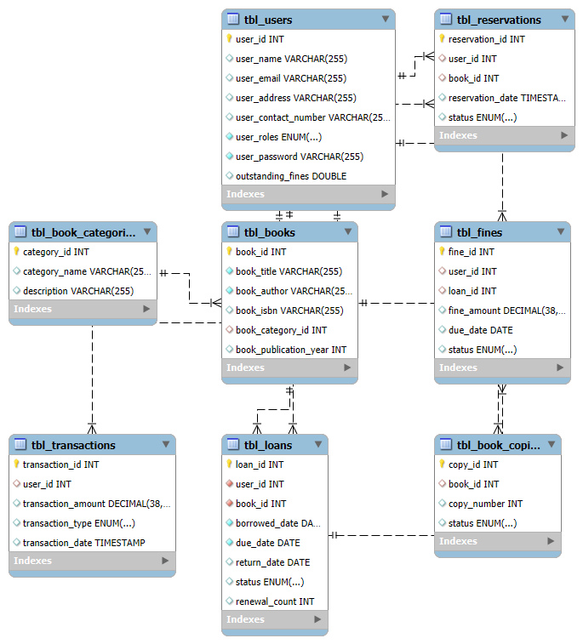
Database & System Designs: ERD
Notes:
The ERD showcase the database and how each table interact with one another. The core of the database are the tbl_books table, the tbl_users tables and the tbl_loans table. I have also build several other tables such as tbl_reservations and tbl_transactions, which are not fully used in this implementation for scalability purposes and ensure that the database is well-structured .

Slide 12
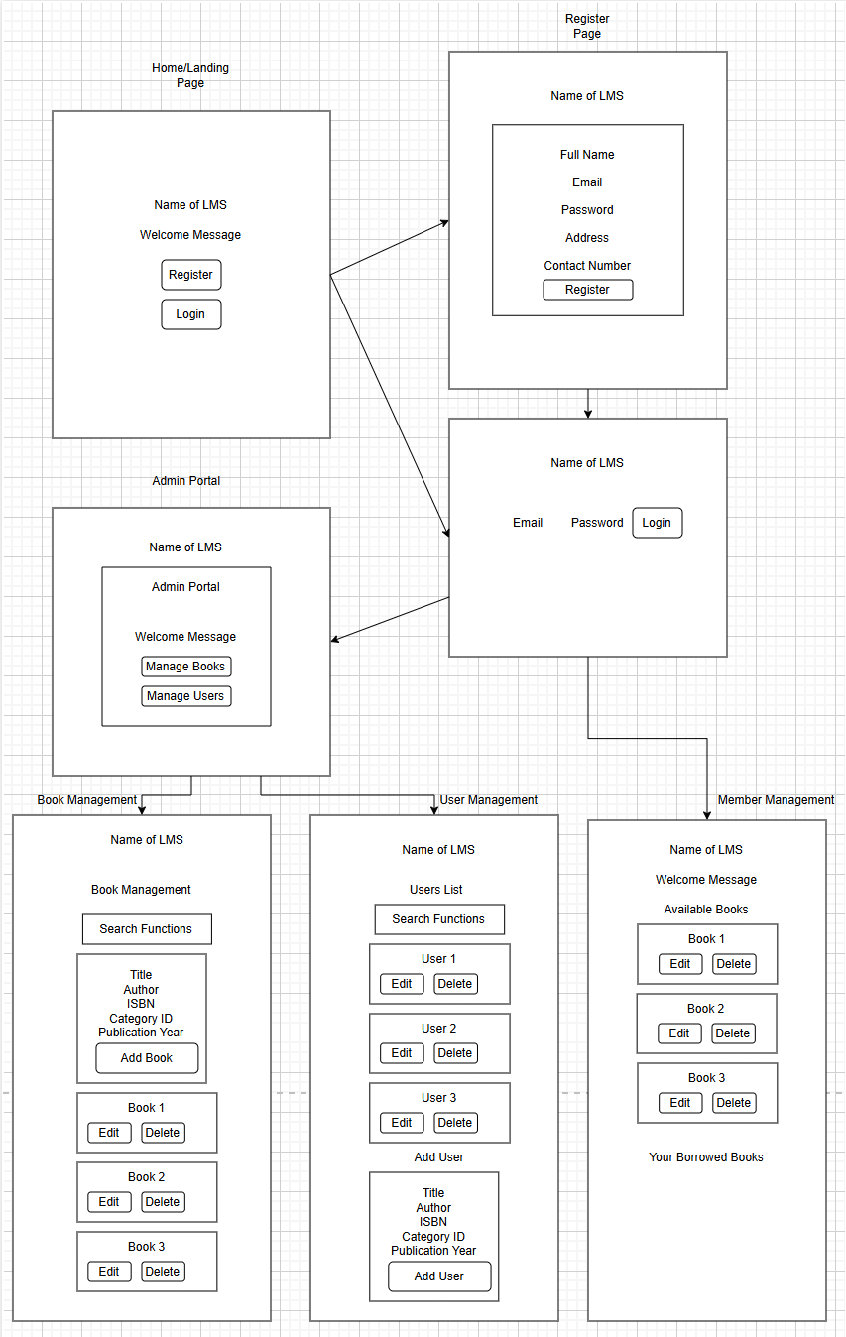
Database & System Designs: Wireframes
Notes:
📌 Wireframes – Demonstrate system flow for user registration, book searches, and borrowing.
In designing the LMS, I want the system flow to be intuitive. Hence I have used a rather clean and simple UI. Upon visiting the page, the users will be directed to the home page, which welcomes the user and ask the user to either register himself or login. If the user chose to register, upon filling in the form, and click register, the user will be prompted if he or she has successfully registered, and will be directed to the login page. Upon successful login, the frontend will capture the credentials and determine if the user is an admin or member. If the user is an admin (librarian), the user will be directed to the admin portal, which he will be welcomed and thje admin can choose to either visit the Book Management system or the User Management system, If the admin choose to visit the book management system, he can search, add, edit or delete books, and likewise for user management system. If upon successful login, the frontend determines the user is a member, the user will be directed to the Member Portal, where the member can borrow books, search for books, or return books, or view own borrowing records.

Slide 13
API Endpoints – Admin
Action | HTTP Method | Endpoint | Description
Admin Login | POST | /api/users/login | Authenticates admin users.
Add Book | POST | /api/books/add | Adds a new book to the library.
Edit Book | PUT | /api/books/update/{bookId} | Updates book details (title, author, category, availability, etc.)
Delete Book | DELETE | /api/books/delete/{bookId} | Removes a book from the library.
View All Books | GET | /api/books | Retrieves a list of all books.
Search Books | GET | /api/books/search?query={searchTerm} | Searches books by title, author, or category.
Notes:
The LMS uses a set of RESTful API endpoints that allows both the librarians and members to perform various actions. These endpoints handle user authentication, book management, borrowing/returning books, and user management through CRUD (Create, Read, Update, Delete) operations.
📌 Admin Endpoints: CRUD operations for books and users.

Slide 14
API Endpoints – Admin (Cont.)
Action | HTTP Method | Endpoint | Description
Manage Users | GET | /api/users | Retrieves a list of all registered users.
Edit User Information | PUT | /api/users/update/{userId} | Updates user details (name, address, contact info).
Delete User | DELETE | /api/users/delete/{userId} | Removes a user from the system.
Notes:
The LMS uses a set of RESTful API endpoints that allows both the librarians and members to perform various actions. These endpoints handle user authentication, book management, borrowing/returning books, and user management through CRUD (Create, Read, Update, Delete) operations.

Slide 15
API Endpoints – Member (Cont.)
Action | HTTP Method | Endpoint | Description
User Registration | POST | /api/users/register | Registers a new member
User Login | POST | /api/users/login | Authenticates a member.
View Books | GET | /api/books | Retrieves available books.
Search Books | GET | /api/books/search?query={searchTerm} | Searches books by title, author, or category.
Borrow Book | GET | /api/borrow/{bookId} | Allows a member to borrow a book.
Notes:
📌 Authentication Endpoints: Secure login and registration.
📌 Member Endpoints: Searching for books, borrowing, and returning them.

Slide 16
API Endpoints – Member (Cont.)
Action | HTTP Method | Endpoint | Description
Search Books | GET | /api/books/search?query={searchTerm} | Searches books by title, author, or category.
Borrow Book | POST | /api/borrow/{bookId} | Allows a member to borrow a book.
Return Book | POST | /api/return/{bookId} | Allows a member to return a borrowed book.
View Borrowing History | GET | /api/users/{userId}/history | Retrieves a user's borrowing history.
Notes:
RESTful API design ensures smooth interaction between frontend and backend.

Slide 17
Test Cases - UATs
User Management UATs
User Registration Test
User Login Test
Admin Management Tests
Book Management UATs
Book Addition Test
Book Editing & Deletion Test
Book Search
Notes:
To validate the system, I conducted multiple User Acceptance Tests (UATs): 📌 User Management Tests – Registration, login, and role-based access. 📌 Book Management Tests – Adding, editing, and searching books. These tests confirm the system meets functional requirements.

Slide 18
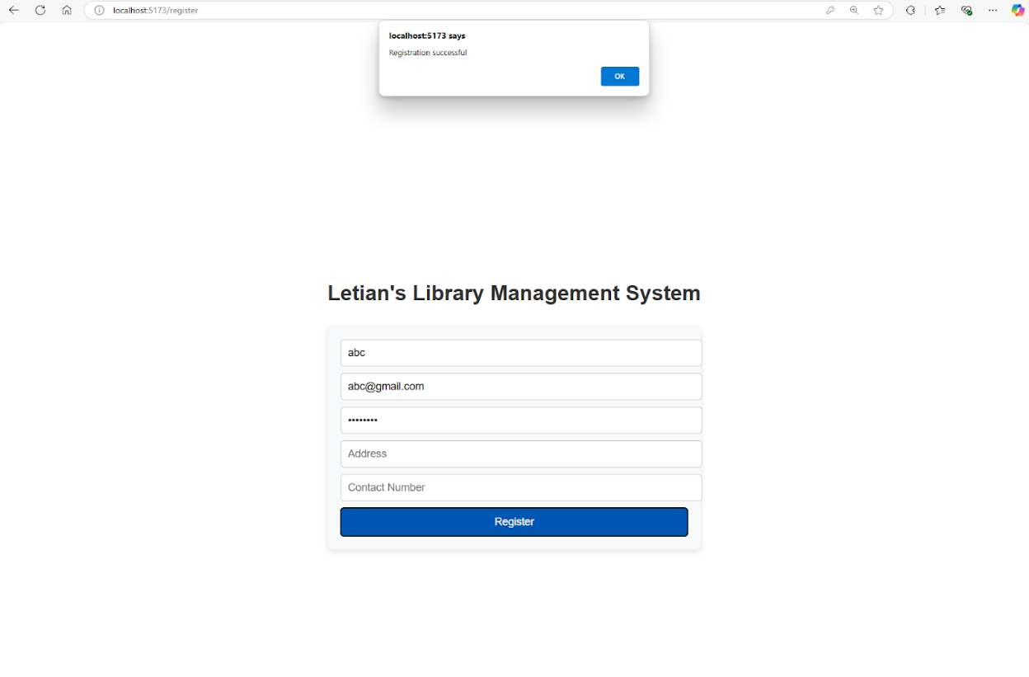
Successful User Registration
Notes:
Here are some of the UAT examples that I have checked:
The first is to test the behavior of a successful user registration. Upon successful registration, the user will be prompted on the frontend that registration is successful.

Slide 19
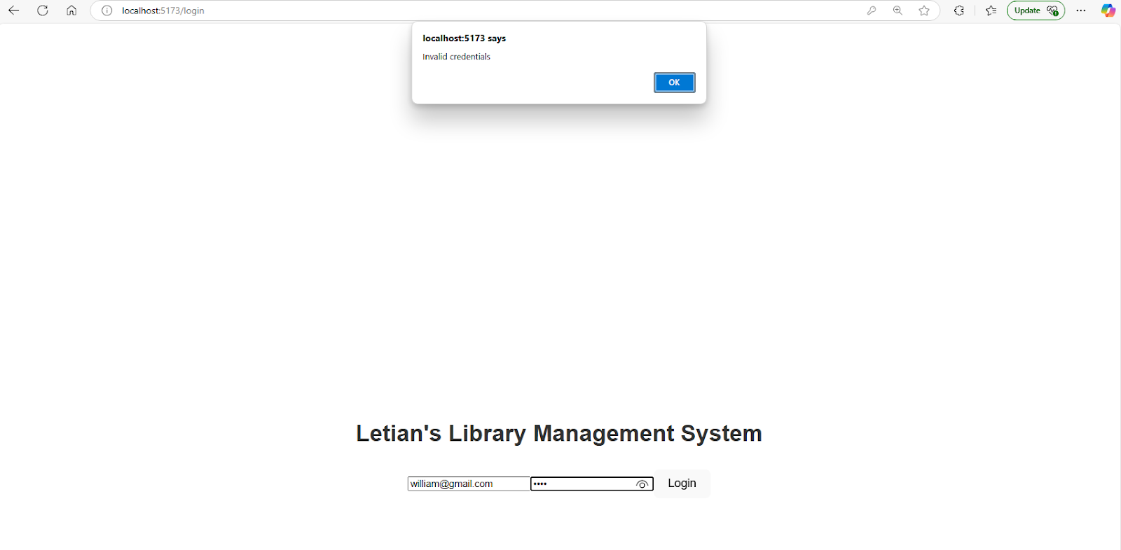
Failed User Login with wrong password
Notes:
If the user enter the wrong password, userEmail combination, an alert will be shown on the frontend that the credentials are invalid.

Slide 20
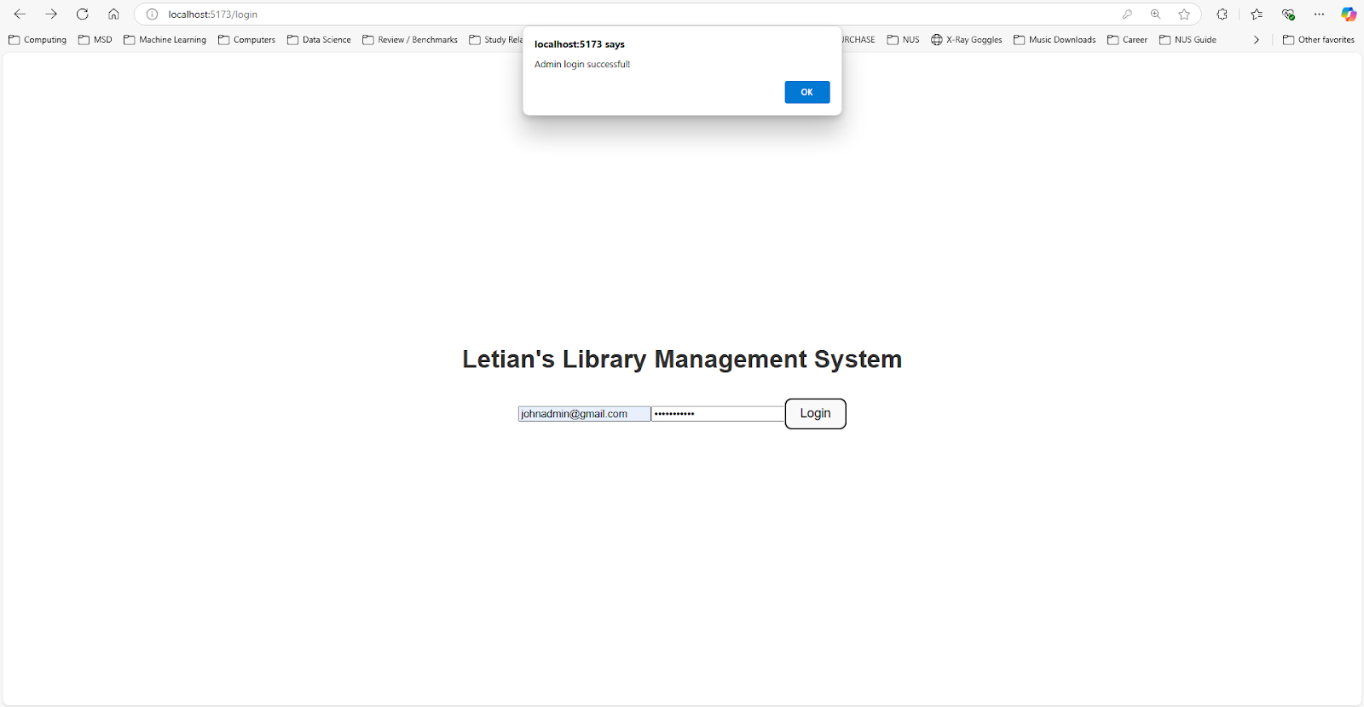
Successful log in by an admin
Notes:
If the login is successful, the alert will say that the login is successful and indicate which portal the user will be directed to. In this case, it is the admin portal.

Slide 21
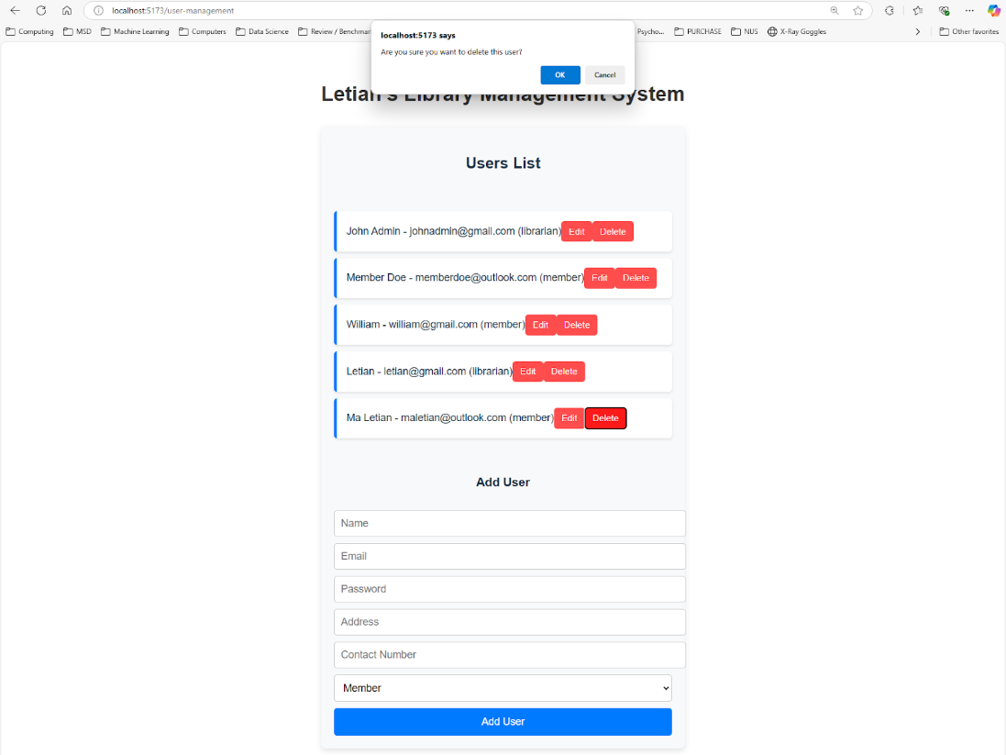
Delete a User
Notes:
The Admin can delete users, when deleting users, an alert will ask the user to confirm if the user really want to delete the user.

Slide 22
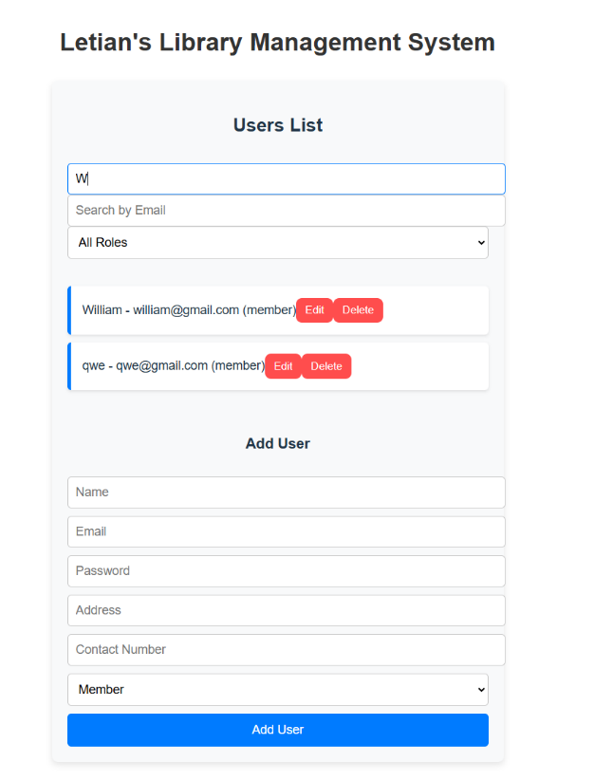
Search a User by Name
Notes:
The search functionality is also implemented, the admin can filter the users or books by several criterias. In this case, the admin search the user name which contains w, and the corresponding users will be reflected.

Slide 23
Challenges and Solutions
User Management Issues
Authentication & Authorization Challenges
CRUD Operations for Books & Users
Frontend Challenges
API Communication Issues
Navigation & Routing Challenges
Notes:
While developing the system, I faced challenges such as: 🔹 User authentication issues – Solved using JWT tokens for secure access. 🔹 CRUD operations complexity – Implemented structured API endpoints. 🔹 Frontend navigation issues – Used React Router for seamless transitions. 🔹 Data integrity concerns – Enforced validation rules in MySQL.
Each challenge provided a valuable learning experience.
1. User Management issues
Implementing role-based access control to restrict admin functionalities.
Ensuring only admins (librarians) can manage books and users, while members can only perform borrowing-related actions.
Disallowing adding new users from the frontend, requiring users to register via a separate flow.
Implementing validation for user details (e.g., ensuring required fields like username, password, email, address, and contact number).
2. Authentication & Authorization Challenges
Storing and handling JWT tokens properly for session management.
Decoding JWT tokens to extract user roles (librarian or member) and redirecting them to the correct portal.
Ensuring proper access restrictions to the Admin Portal and Member Portal.
3. CRUD Operations for Books & Users
Implementing full CRUD functionality (Create, Read, Update, Delete) for books and users.
Allowing password, address, and contact number edits while ensuring security.
Preventing unauthorized actions (e.g., restricting member access to book management).
4. Frontend Challenges: Handling state updates correctly when adding, updating, and deleting users and books.
Implementing search and filtering functionality for users and books.
Maintaining separate views for admin and member functionalities.
5. API Communication Issues
Correctly formatting requests and responses for user authentication and CRUD operations.
Handling errors and displaying proper error messages when requests fail.
Ensuring API endpoints are properly structured (/api/users/register, /api/users/update, etc.).
6. Navigation & Routing Challenges
Ensuring correct navigation logic after login, based on the user’s role.
Restricting access to admin pages unless the user is a librarian

Slide 24
Future Enhancements
Mobile app integration
Advanced search and recommendation system
Integration with external libraries or APIs
Enhanced reporting and analytics for librarians
Fully develop the Book Categories System
Develop a Reservation System
Notes:
To further improve the system, I plan to add: 📌 Mobile App Integration – Extend accessibility for users. 📌 Advanced Search & Recommendations – AI-based book suggestions. 📌 Integration with External Libraries – Borrow books from other sources. 📌 Enhanced Reporting for Librarians – Generate insights on book usage. 📌 Reservation & Fine System – Improve borrowing management.
These enhancements will increase system usability and efficiency.
As the Library Management System evolves, I forsee several enhancements to be made to improve the user experience, efficiency, and scalability. Below are some key future improvements and their impact on the system:
Mobile App Integration: Develop a mobile application for Android and iOS to allow members to:
Search for books and view availability on the go.
Reserve and renew books directly from their smartphones.
Receive real-time notifications for due dates, fines, or reserved books.
This could:
Increases accessibility and convenience for users.
Encourages higher engagement and more active library use.
Push notifications improve communication between the library and members.
2. Implement AI-driven search functionality allowing:
Fuzzy search (e.g., finding books even if the title is misspelled).
Filtering by category, author, publication year, or availability.
Personalized book recommendations based on borrowing history.
This could:
Improves book discoverability for users.
Encourages more borrowing activity by providing personalized suggestions.
Helps students and researchers find relevant books more efficiently.
3. Integration with External Libraries or APIs allowing: Connect the LMS with public libraries and online book repositories like:
Google Books API to fetch book metadata (author, summary, ratings).
ISBN databases for automatic book details entry.
Open Library API for digital books and external references.
This could:
Reduces manual data entry by fetching book details automatically.
Expands available resources by linking with external libraries.
Increases engagement by integrating with digital lending platforms.
4. Enhanced Reporting and Analytics for Librarians:
Develop a dashboard for librarians with:
Borrowing trends (popular books, peak borrowing periods).
Late return statistics and fine collection insights.
Member activity tracking (active vs. inactive users).
Impact:
Helps librarians make data-driven decisions about book purchases and policies.
Identifies trends in book demand to optimize inventory.
Improves operational efficiency with clear insights into book usage.
5. Fully Develop the Book Categories System
Potential Improvement:
Implement multi-level categorization (e.g., Fiction > Mystery > Crime).
Enable tagging and genre-based recommendations.
Allow custom categories for different types of libraries (academic, public, corporate).
Impact:
Improves organization and searchability of books.
Makes it easier for users to discover books in specific interests.
Helps librarians manage inventory more effectively.
6. Develop a Reservation System
Potential Improvement:
Allow members to reserve books and get notified when available.
Implement queue management for high-demand books.
Set automatic cancellation rules if a book is not picked up within a timeframe.
Impact:
Reduces frustration of unavailable books by ensuring fair access.
Provides a more structured borrowing system.
Encourages better library circulation and prevents hoarding of books.

Slide 25
Conclusions
Developed a functional Library Management System with role-based access for librarians and members.
Implemented secure authentication, book management, and lending features.
Designed a scalable and maintainable system using Spring Boot, React, and MySQL.
Notes:
✅ Successfully developed a functional and scalable Library Management System. ✅ Implemented secure authentication, book management, and lending features. ✅ Designed a maintainable system using Spring Boot, React, and MySQL.
Thank you for your time! I’m happy to take any questions.

